Slide 1
N. Rizk
COSC 3337 : Data Science I
College of Natural and Applied Sciences
Department of Computer Science
University of Houston

Slide 2
Dimensionality reduction in Supervised learning: feature selection

Slide 3
Model selection:
Dosbol Notes
Regularization (shrinkage )
⬅➔ Subset selection (reduce the variance )

Slide 4
Why feature selection is important?
May Improve performance of classification algorithm
Classification algorithm may not scale up to the size of the full feature set either in sample or time
Allows us to better understand the domain
Cheaper to collect a reduced set of predictors
Safer to collect a reduced set of predictors

Slide 5
Feature Selection
Definition
A process that chooses an optimal subset of features according to a objective function
Objectives
To reduce dimensionality and remove noise
To improve mining performance
Speed of learning
Predictive accuracy
Simplicity and comprehensibility of mined results

Slide 6
Deployment of Feature Selection Methods
Based on their relation to the induction algorithm feature selection methods can be grouped as:
Embedded: They are a part of induction algorithms
Filter: They are separate processes from the induction algorithms
Wrapper: They are also separate processes from induction algorithm but they use induction algorithm as a subroutine

Slide 7
Deployment of Feature Selection Methods

Slide 8
Motivation
The objective of feature selection is three-fold:
Improving the prediction performance of the predictors
Providing a faster and more cost-effective predictors
Providing a better understanding of the underlying process that generated the data

Slide 9
Filters,Wrappers, and Embedded methods
Feature subset
All features
Filter
Predictor
Multiple Feature subsets
All features
Predictor
Wrapper
Feature subset
Embedded method
All features
Predictor
Notes:
Wrappers are

Slide 10

Feature Subset Selection
Filter Methods
Select subsets of variables as a pre-processing step, independently of the used classifier!!
Note that Variable Ranking-FS is a filter method
Feature selection is independent of the prediction model (Information Gain, Minimum Redundancy Maximum Relevance, etc.)
10/54

Slide 11
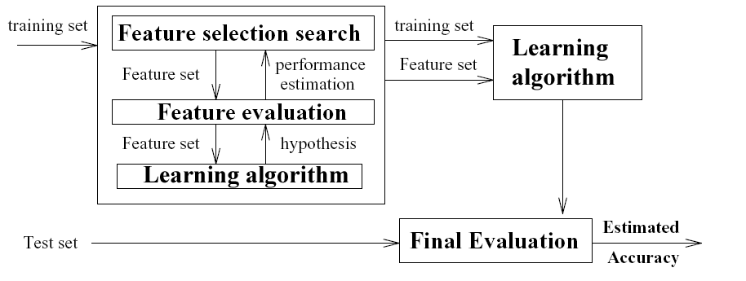
Feature Subset Selection
Wrapper Methods
Feature selection is integrated in the prediction model, typically very slow, not able to incorporate domain knowledge (LASSO, SVM-RFE…)
11/54

Slide 12
Filters vs Wrappers: Filters
In the filter approach we do not rely on running a particular classifier and searching in the space of feature subsets; instead we select features on the basis of statistical properties. A classic example is univariate associations:
FEATURE ASSOCIATION WITH TARGET
Threshold gives suboptimal solution
{A} 91%
{B} 90%
Threshold gives optimal solution
{C} 89%
Threshold gives suboptimal solution

Slide 13
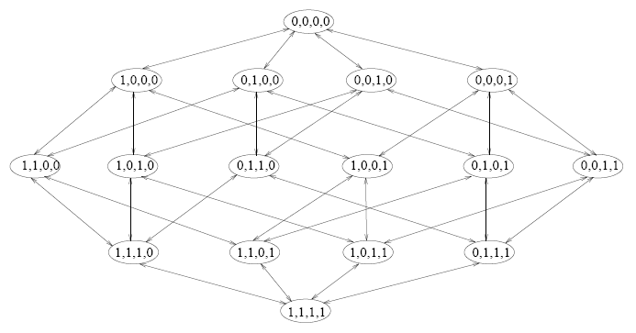
Forward Selection (wrapper)
Start
n
n-1
n-2
1
…
Also referred to as SFS: Sequential Forward Selection

Slide 14
Forward Selection (embedded)
Start
n
n-1
n-2
1
…
Guided search: we do not consider alternative paths.

Slide 15
Forward Selection with GS
Stoppiglia, 2002. Gram-Schmidt orthogonalization.
Select a first feature X_{ν(1)}with maximum cosine with the target cos(x_{i}, y)=x.y/||x|| ||y||
For each remaining feature X_{i}
Project X_{i} and the target Y on the null space of the features already selected
Compute the cosine of X_{i} with the target in the projection
Select the feature X_{ν(k)}with maximum cosine with the target in the projection.
Embedded method for the linear least square predictor

Slide 16
Forward Selection w. Trees
Tree classifiers,
like CART (Breiman, 1984) or C4.5 (Quinlan, 1993)
MORE PURE TO SELECT
At each step, choose the feature that “reduces entropy” most. Work towards “node purity”.
f₂
All the data
f₁
Choose f₁
Choose f₂

Slide 17
Backward Elimination (wrapper)
Also referred to as SBS: Sequential Backward Selection
1
n-2
n-1
n
WE CAN DO BACKWARD AS WELL
…
Start

Slide 18


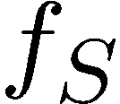
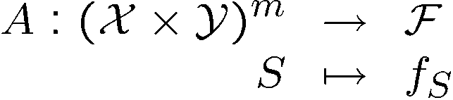

Embedded
Definition: an embedded feature selection method is a machine learning algorithm that returns a model using a limited number of features.
Training set
Learning algorithm
output

Slide 19
Backward Elimination (embedded)
1
n-2
n-1
n
…
Start

Slide 20
Backward Elimination: RFE Recursive Feature Elimination
Start with all the features.
Train a learning machine f on the current subset of features by minimizing a risk functional J[f].
For each (remaining) feature X_{i}, estimate, without retraining f, the change in J[f] resulting from the removal of X_{i}.
Remove the feature X_{ν(k)} that results in improving or least degrading J.
RFE-SVM, Guyon, Weston, et al, 2002
RFE WILL DO AUTOMATICALLY
Embedded method for SVM, kernel methods, neural nets.

Slide 21
RFE works on feature ranking system
1- The model is fit on linear regression based on all variables.
2-Then it calculates variable coefficients and their importance.
3-Then It ranks the variable on the basis on linear regression fit and
4-Then remove low ranking variable in each iteration.
HOW TO DO DATA ANALYSIS?
MANUALLY

Slide 22
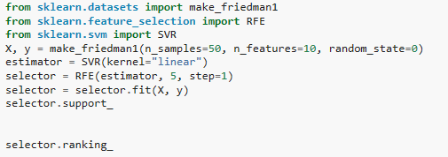
scikit package can do this automatically by defining the number of features needed to reduce to
WHAT IS THE RFE? PART OF FEATURE SELECTION

Slide 23
Filter Methods | Wrapper Methods
Usually fast | Learner is considered a black-box
Provide generic selection of features, not tuned by given learner (universal) | Interface of the black-box is used to score subsets of variables according to the predictive power of the learner when using the subsets.
This is also often criticised (feature set not optimized for used classifier) | Results vary for different learners
Sometimes used as a preprocessing step for other methods | One needs to define: How to search the space of all possible variable subsets ? How to assess the prediction performance of a learner ?
WHEN TO USE? BEFORE FILT THE METHOD

Slide 24
Add/Remove feature summary
Many algorithms can be turned into embedded methods for feature selections by using the following approach:
Choose an objective function that measure how well the model returned by the algorithm performs
“Differentiate” (or sensitivity analysis) this objective function according to the σ parameter (i.e. how does the value of this function change when one feature is removed and the algorithm is rerun)
Select the features whose removal (resp. addition) induces the desired change in the objective function (i.e. minimize error estimate, maximize alignment with target, etc.)
What makes this method an ‘embedded method’ is the use of the structure of the learning algorithm to compute the gradient and to search/weight relevant features.

Slide 25
Model selection: choosing estimators and their parameters

Slide 26
from sklearn import datasets, svm
digits = datasets.load_digits()
X_digits = digits.data
y_digits = digits.target
svc = svm.SVC(C=1, kernel='linear')
svc.fit(X_digits[:-100], y_digits[:-100]).score(X_digits[-100:], y_digits[-100:])
import numpy as np
X_folds = np.array_split(X_digits, 3)
y_folds = np.array_split(y_digits, 3)
scores = list()
for k in range(3):
# We use 'list' to copy, in order to 'pop' later on
X_train = list(X_folds)
X_test = X_train.pop(k)
X_train = np.concatenate(X_train)
y_train = list(y_folds)
y_test = y_train.pop(k)
y_train = np.concatenate(y_train)
scores.append(svc.fit(X_train, y_train).score(X_test, y_test))
print(scores)

Slide 27
from sklearn.model_selection import KFold, cross_val_score
X = ["a", "a", "a", "b", "b", "c", "c", "c", "c", "c"]
k_fold = KFold(n_splits=5)
for train_indices, test_indices in k_fold.split(X):
print('Train: %s | test: %s' % (train_indices, test_indices))
[svc.fit(X_digits[train], y_digits[train]).score(X_digits[test], y_digits[test])
for train, test in k_fold.split(X_digits)]
cross_val_score(svc, X_digits, y_digits, cv=k_fold, n_jobs=-1)
cross_val_score(svc, X_digits, y_digits, cv=k_fold, scoring='precision_macro')

Slide 28
digits = datasets.load_digits()
X = digits.data
y = digits.target
svc = svm.SVC(kernel='linear')
C_s = np.logspace(-10, 0, 10)
scores = list()
scores_std = list()
for C in C_s:
svc.C = C
this_scores = cross_val_score(svc, X, y, cv=5, n_jobs=1)
scores.append(np.mean(this_scores))
scores_std.append(np.std(this_scores))
# Do the plotting
import matplotlib.pyplot as plt
plt.figure(1, figsize=(4, 3))
plt.clf()
plt.semilogx(C_s, scores)
plt.semilogx(C_s, np.array(scores) + np.array(scores_std), 'b--')
plt.semilogx(C_s, np.array(scores) - np.array(scores_std), 'b--')
locs, labels = plt.yticks()
plt.yticks(locs, list(map(lambda x: "%g" % x, locs)))
plt.ylabel('CV score')
plt.xlabel('Parameter C')
plt.ylim(0, 1.1)
plt.show()
import numpy as np
from sklearn.model_selection import cross_val_score
from sklearn
import datasets, svm
FINAL EXAM
Cross_val_score
How to do plotting?
Svc not much

Slide 29
from sklearn.model_selection import LeaveOneGroupOut
X = np.array([[1, 2], [3, 4], [5, 6], [7, 8]])
y = np.array([1, 2, 1, 2])
groups = np.array([1, 1, 2, 2])
logo = LeaveOneGroupOut()
logo.get_n_splits(X, y, groups)
logo.get_n_splits(groups=groups)
# 'groups' is always required
print(logo)
for train_index, test_index in logo.split(X, y, groups):
print("TRAIN:", train_index, "TEST:", test_index)
X_train, X_test = X[train_index], X[test_index]
y_train, y_test = y[train_index], y[test_index]
print(X_train, X_test, y_train, y_test)
EXTRA

Slide 30
from sklearn.model_selection import KFold, cross_val_score
from sklearn.preprocessing import PolynomialFeatures
from sklearn.linear_model import LinearRegression
from sklearn.pipeline import Pipeline
x = pd.DataFrame(Auto.horsepower)
y = Auto.mpg
model = LinearRegression()
model.fit(x, y)
print model.intercept_
print model.coef_
k_fold = KFold(n_splits=x.shape[0])
test = cross_val_score(model, x, y, cv=k_fold, scoring = 'neg_mean_squared_error', n_jobs=-1)
print np.mean(-test)

